Slide 1

FINAL YEAR PROJECT
VEDU
A Modern WebRTC Virtual Classroom Solution
Scalable Real-time Virtual Education Platform leveraging Java Spring Boot, WebRTC, and equipped with some function of LMS
By:
Harshit Raj
Batch: b1 ,Roll no: B10
College Id: 444-9792
University Roll:
2444440080033
2026
Cimage College

Slide 2
Introduction
Problem Statement & Solution Overview
Current Challenges
VEDU Solution
1
Scalability Limitations
High-Performance Architecture
Existing e-learning platforms struggle to handle concurrent video streams beyond 50-100 participants, causing server crashes during peak usage.
Built on Spring Boot with WebRTC technology, supporting 500+ concurrent users with sub-100ms latency through optimized media server configuration.
2
High Latency Issues
Traditional video conferencing tools introduce 300-500ms delays, disrupting real-time interaction and collaborative learning experiences.
Containerized Deployment
Deployment Complexity
Docker-based orchestration enables seamless horizontal scaling, automated load balancing, and simplified DevOps workflows for educational institutions.
3
Monolithic architectures lack containerization, making deployment, scaling, and maintenance operations cumbersome and error-prone.
Modern WebRTC Integration
4
Session Duration
Small session duration is insufficient for a standard deep-learning session.
Leverages OpenVidu and LiveKit for peer-to-peer media streaming with Redis caching, ensuring reliable signal handling and session management.
Project Objective: Develop a production-ready, containerized video conferencing platform specifically designed for educational environments with enterprise-grade scalability and reliability.

Slide 3
System Requirements Specification
Hardware, Software & User Role Definitions
Hardware ( for deployment)
Technologies
User Roles
Server Platform
Docker 24.0+
Administrator
Ubuntu Server 22.04 LTS (64-bit)
Container orchestration & deployment
• System configuration
• User management
RAM
Java 17 LTS
• Analytics & reports
• Server monitoring
8GB Minimum, 16GB Recommended
Runtime environment for Spring Boot
Teacher
Storage
Spring Boot 3.2
• Create virtual sessions
100GB SSD for OS + Media
Backend framework with WebFlux
• Manage participants
• Share screen/content
Network
PostgreSQL 15
• Record meetings
1Gbps Ethernet, Static IP
Primary database via Supabase
Student
• Join scheduled classes
• Participate in discussions
• Access recordings
• View attendance

Slide 4
System Architecture
End-to-End Process Flow & Component Integration
Process Logic Flow
Docker Orchestration
User Authentication
Session Creation
Signal Handling
Container deployment & scaling
Supabase/PostgreSQL auth
OpenVidu WebRTC setup
LiveKit + Redis realtime
Step 1
Step 2
Step 3
Step 4
Core Components
Supporting Services
Spring Boot API Gateway
LiveKit Signal Server
RESTful endpoints, JWT security, request routing
Real-time signaling, participant management
Supabase PostgreSQL
Redis Cache Layer
User data, session metadata, attendance logs
Session state, token storage, rate limiting
OpenVidu Media Server
MongoDB (Optional)
WebRTC handling, video routing, recording
Chat messages, notifications, logs

Slide 5
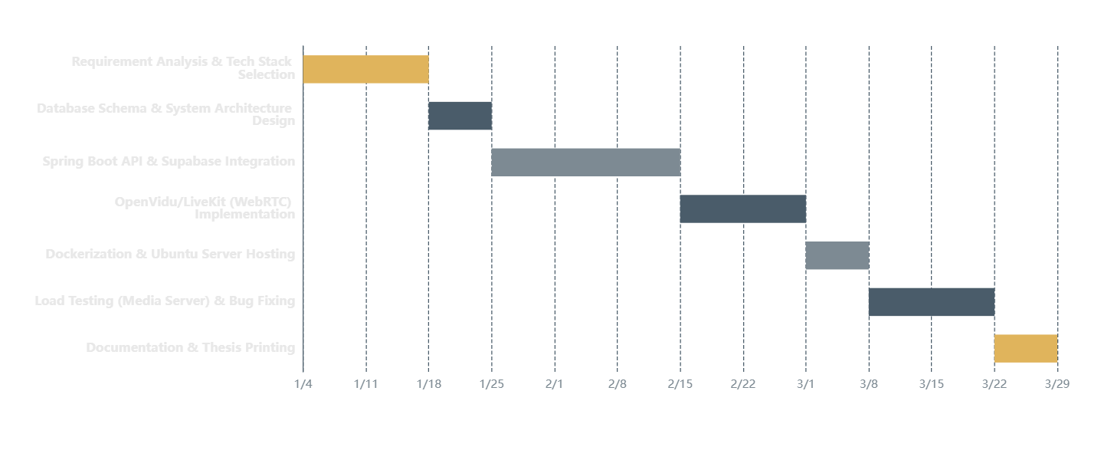
Project Timeline
3-Month Development Roadmap: January 4 – 28feb, 2026
2
1
5
1
2
1
Weeks Analysis
Week Design
Weeks Development
Week Deployment
Weeks Testing
Week Final

Slide 6
Data Dictionary
users
schedules
Student Table
Authentication
Session management
Tracking
Field | Type | Constraints
id | UUID | PRIMARY KEY
Email | VARCHAR(255) | UNIQUE, NOT NULL
password_hash | VARCHAR(255) | NOT NULL
Role | ENUM | admin/teacher/student
Field | Type | Constraints
id | UUID | PRIMARY KEY
topic | VARCHAR(100) | UNIQUE, NOT NULL
time | Dateandtime | NOT NULL
teacher_id | UUID | FK → teacher.id
status | VARCHAR(20) | ACTIVE/CLOSED
Field | Type | Constraints
id | UUID | PRIMARY KEY
meeting_id | UUID | FK → meetings.id
student_id | UUID | FK → users.id
Email | VARCHAR(255) | NOT NULL
User Profiles
profiles
Teacher Data teacher
rooms
Field | Type | Constraints
id | UUID | PRIMARY KEY
Email | VARCHAR(255) | UNIQUE, NOT NULL
Specialization | VARCHAR(100) | NOT NULL
Employee ID | VARCHAR(50) | UNIQUE
Storage
Field | Type | Constraints
id | UUID | PRIMARY KEY
user_id | UUID | FK → users.id
Full Name | VARCHAR(255) | NOT NULL
User Type | ENUM | teacher/student
Field | Type | Constraints
id | UUID | PRIMARY KEY
room_id | UUID | FK → schedules.id
file_url | VARCHAR(500) | NOT NULL
duration | INTEGER | Seconds

Slide 7
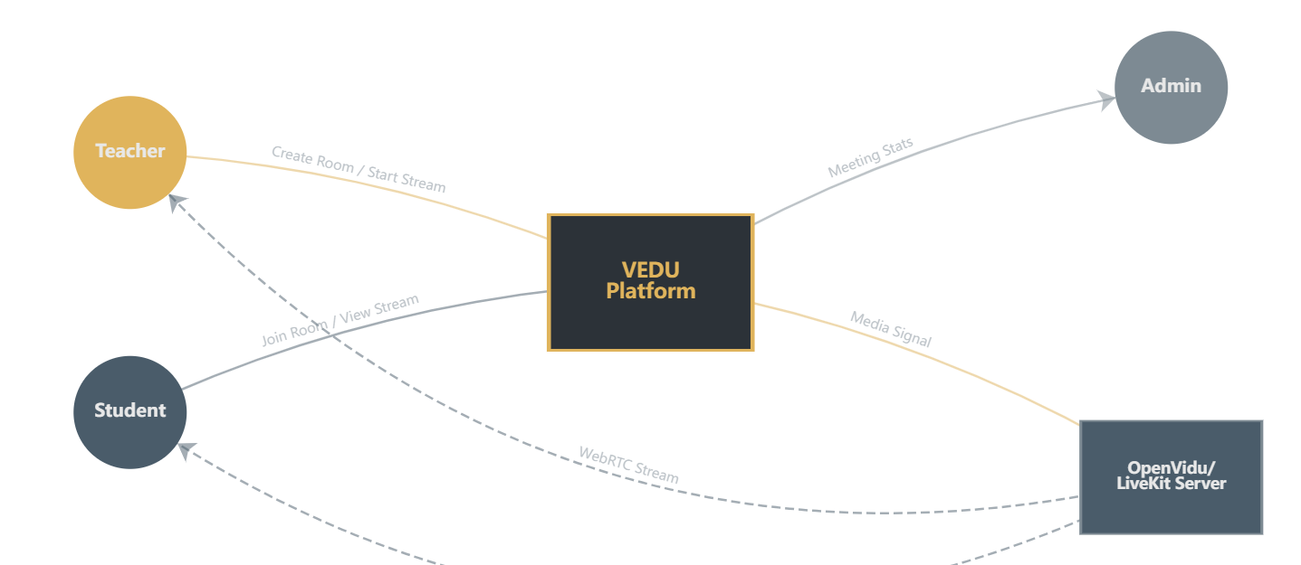
Data Flow Diagram
Context Level (Level 0) - External Entity Interactions
Teacher Actions
Student Actions
Admin Monitoring
Media Processing
Create Room, Start Stream, Manage Session
Join Room, View Stream, Participate
Meeting Stats, User Analytics, Reports
WebRTC Signal, Stream Relay, Recording

Slide 8
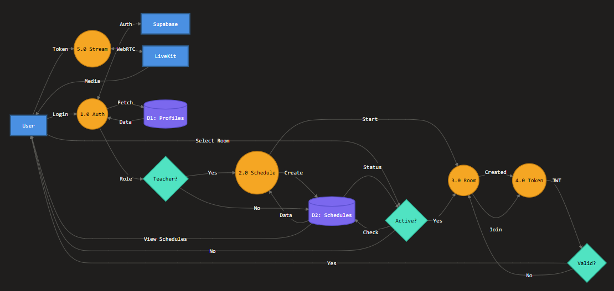
Data Flow Diagram
Level 1 - Internal Process Decomposition
1.0 API Gateway
Authentication, request routing, rate limiting
2.0 WebRTC Controller
Session management, token generation
OpenVidu Server
Media routing, stream processing

Slide 9
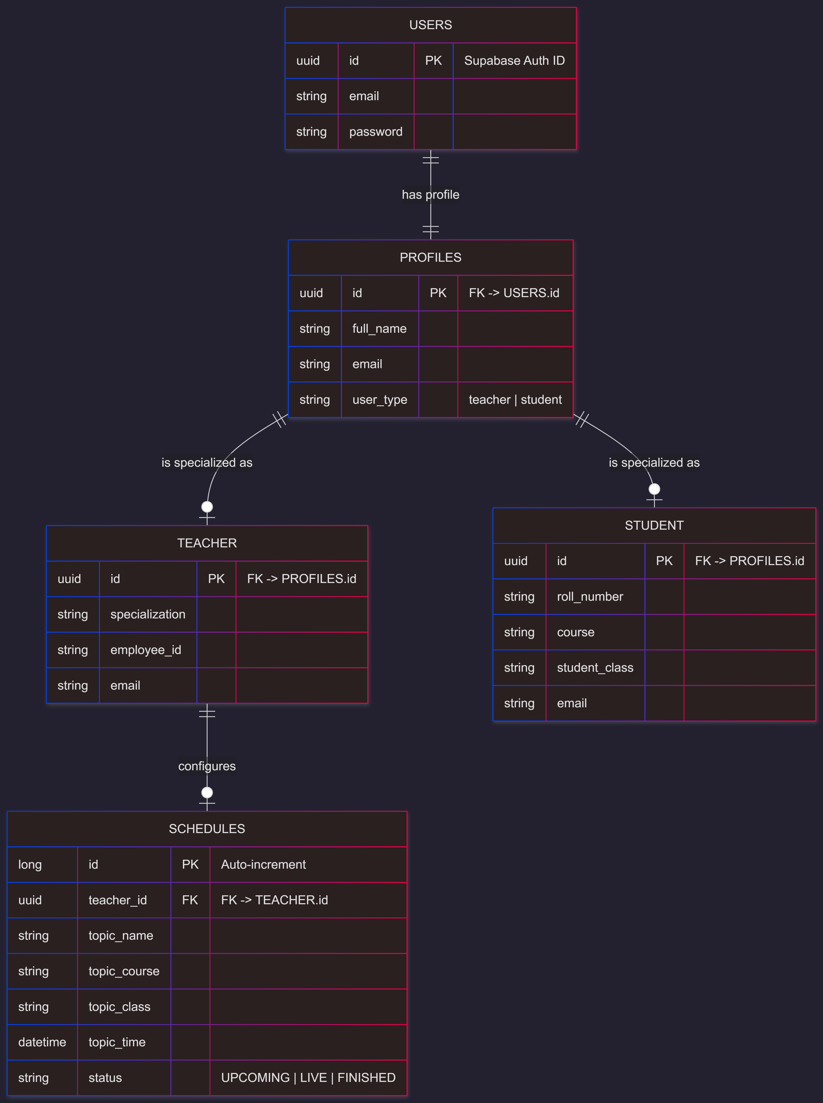
Entity-Relationship Diagram
Database Structure & Entity Relationships
TEACHER
Hosts multiple meetings, subject expertise
MEETING
Virtual session with status tracking
STUDENT
Enrolls in meetings, attendance tracked
ATTENDANCE
Join timestamps, participation logs

Slide 10
User Interface Design
Dashboard, Video Grid & Interactive Components
Dashboard Overview
Video Conference Interface
Scheduled Classes
Upcoming sessions with date, time, and instructor info. Color-coded status indicators (Upcoming/Live/Completed).
Teacher
Student 1
Quick Join Button
Prominent "Join Room" CTA with one-click access to active sessions. Auto-redirect to video interface.
Student 2
Student 3
Recent Activity
Past meetings with access to recordings, attendance reports, and session notes.
Integrated Chat Panel
Teacher:
Welcome everyone!
Key UI Features
Student 1:
Raised Hand 🤚
Responsive Design
Dark/Light Mode
Accessibility (WCAG)
Real-time Updates

Slide 11
Reporting & Analytics
Attendance Tracking & Meeting Duration Analytics
Attendance Reports
Meeting Analytics
PDF Generation & Export
Duration & Engagement Metrics
Participant Lists
Session Duration
Complete roster of all attendees with enrollment numbers, join times, and duration spent in session. Exportable to PDF format.
Track total meeting length, average participant engagement time, and identify optimal session durations for different content types.
Join Timestamps
Engagement Metrics
Precise entry and exit times for each participant. Calculate punctuality metrics and identify late joiners or early leavers.
Monitor active participants, screen sharing duration, chat message frequency, and interaction levels throughout the session.
Attendance Statistics
Visual Dashboards
Aggregate attendance rates across multiple sessions. Generate trend reports for individual students or entire classes.
Interactive charts showing meeting trends, peak usage times, popular features, and system performance metrics.
Use Case: Teachers can generate monthly attendance reports for administrative review and student assessment.
45min
92%
24
Avg Duration
Attendance Rate
Avg Participants

Slide 12

Future Scope & References
Future Enhancements
Technical References
AI Video Summarization
1
Spring Boot Documentation
Official reference guide for Spring Boot 3.2, WebFlux, and reactive programming patterns.
Automated generation of session highlights, key topic extraction, and searchable transcript creation using NLP models.
2
OpenVidu Architecture Guide
WebRTC media server configuration, session management, and deployment best practices.
Interactive Whiteboard
3
LiveKit Documentation
Real-time signaling protocols, participant management, and scalable infrastructure design.
Real-time collaborative drawing canvas with shape tools, text annotations, and multi-user simultaneous editing capabilities.
4
Docker & Containerization
Container orchestration, microservices deployment, and DevOps automation strategies.
Mobile Optimization
Native iOS and Android applications with responsive design, push notifications, and optimized video streaming for mobile networks.
Thank You
Questions & Discussion
vedu.project@university.edu
github.com/vedu-platform

